Slide 1

Phylogenetic Tree Algorithms
April, 2019

Slide 2
Tree of life

Slide 3
Tree of life

Slide 4
Tree of life

Slide 5
Phylogenetic Trees
Non Rooted
Rooted

Slide 6
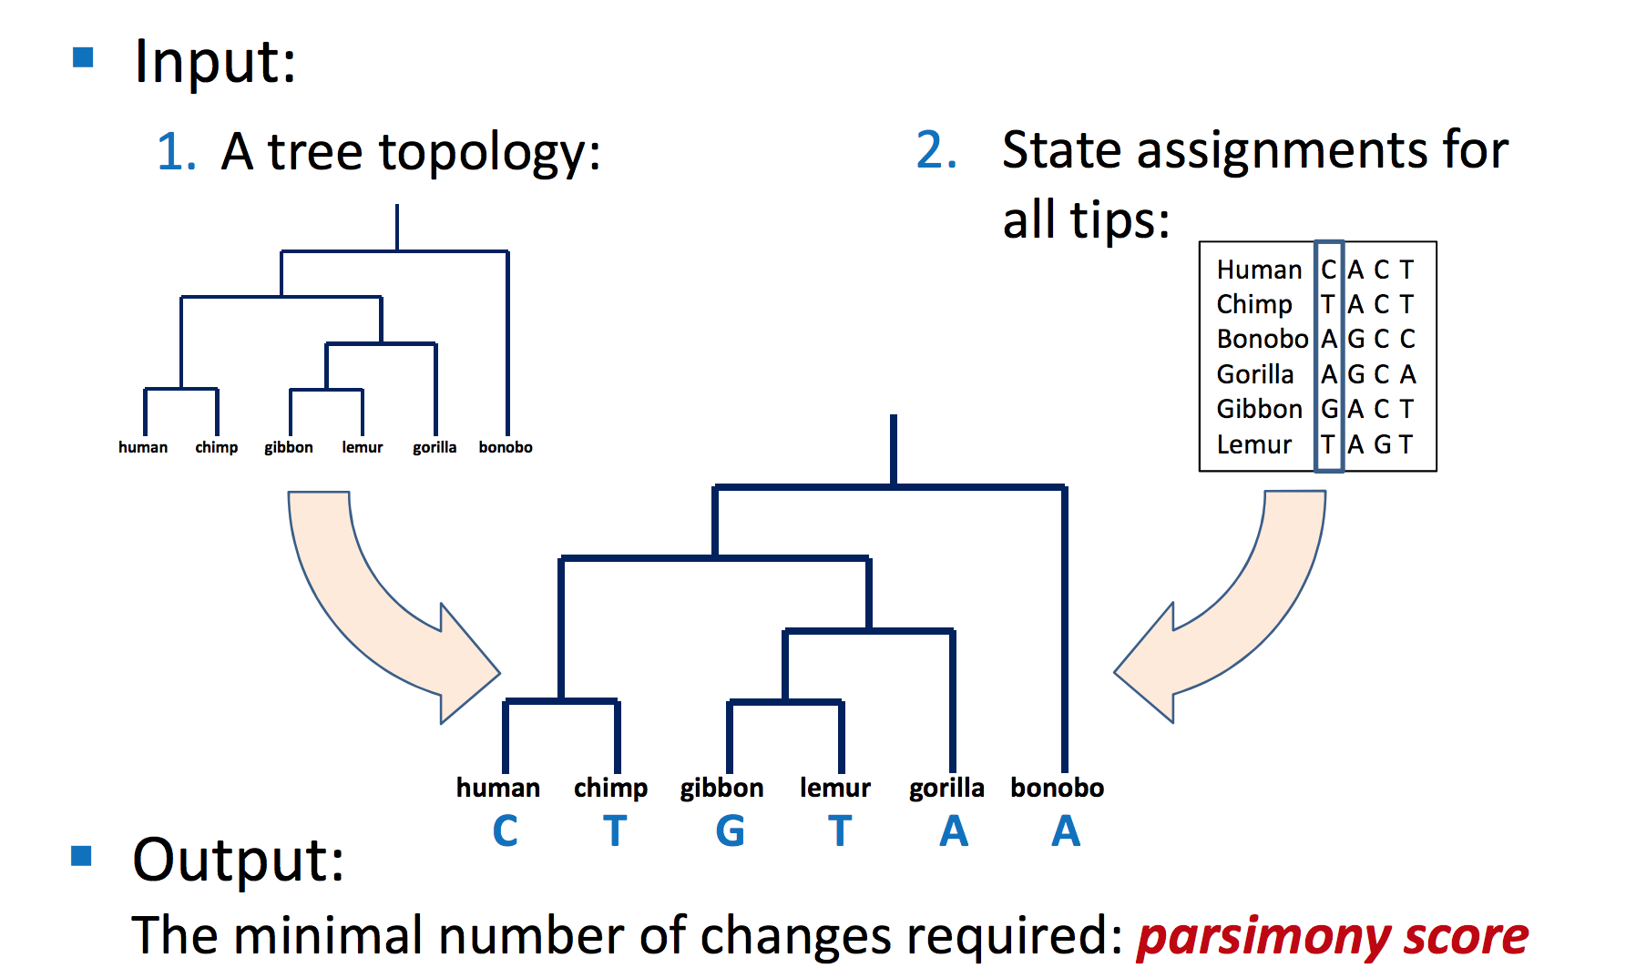
Parsimony Problem

Slide 7
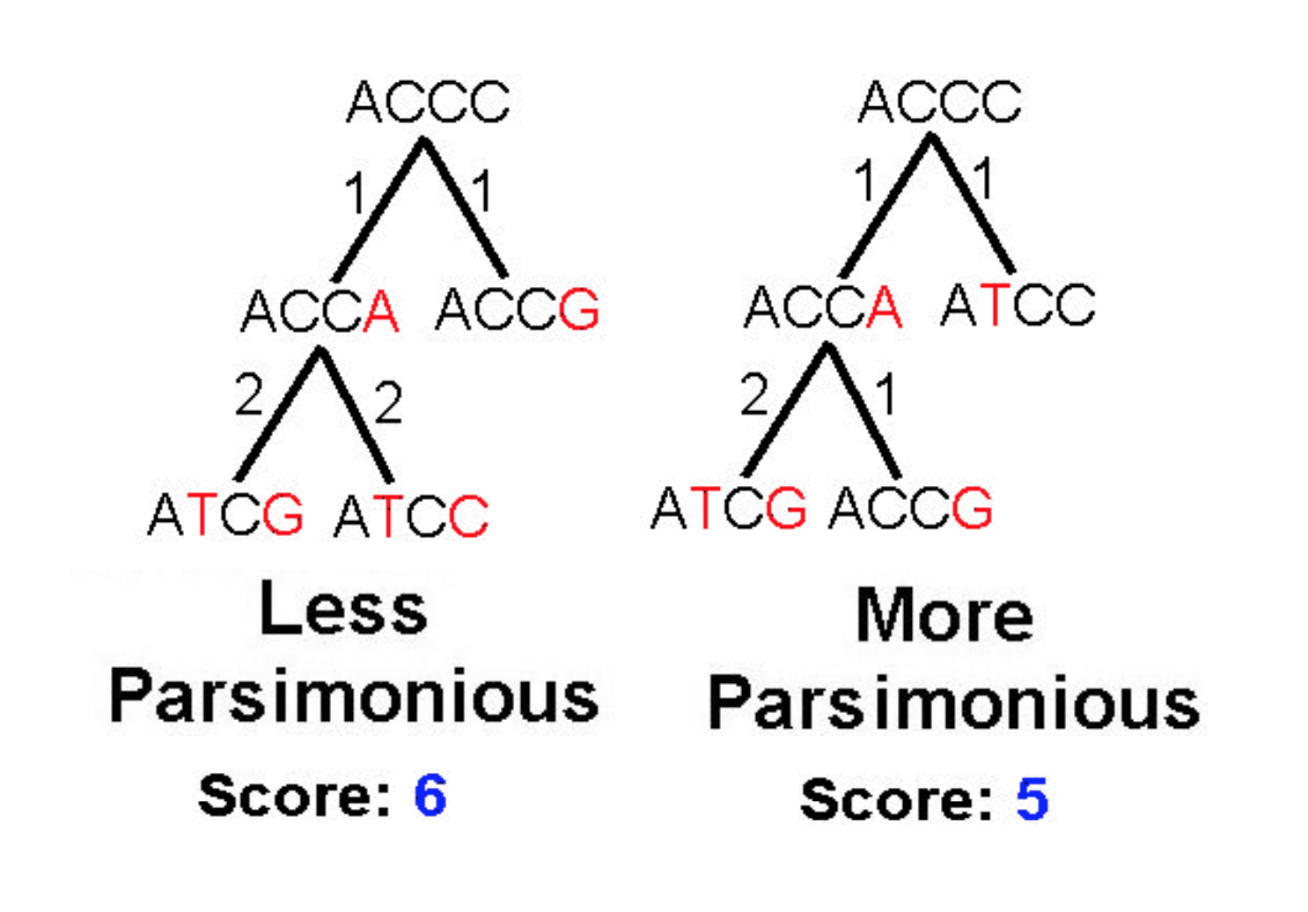
Parsimony Problem

Slide 8
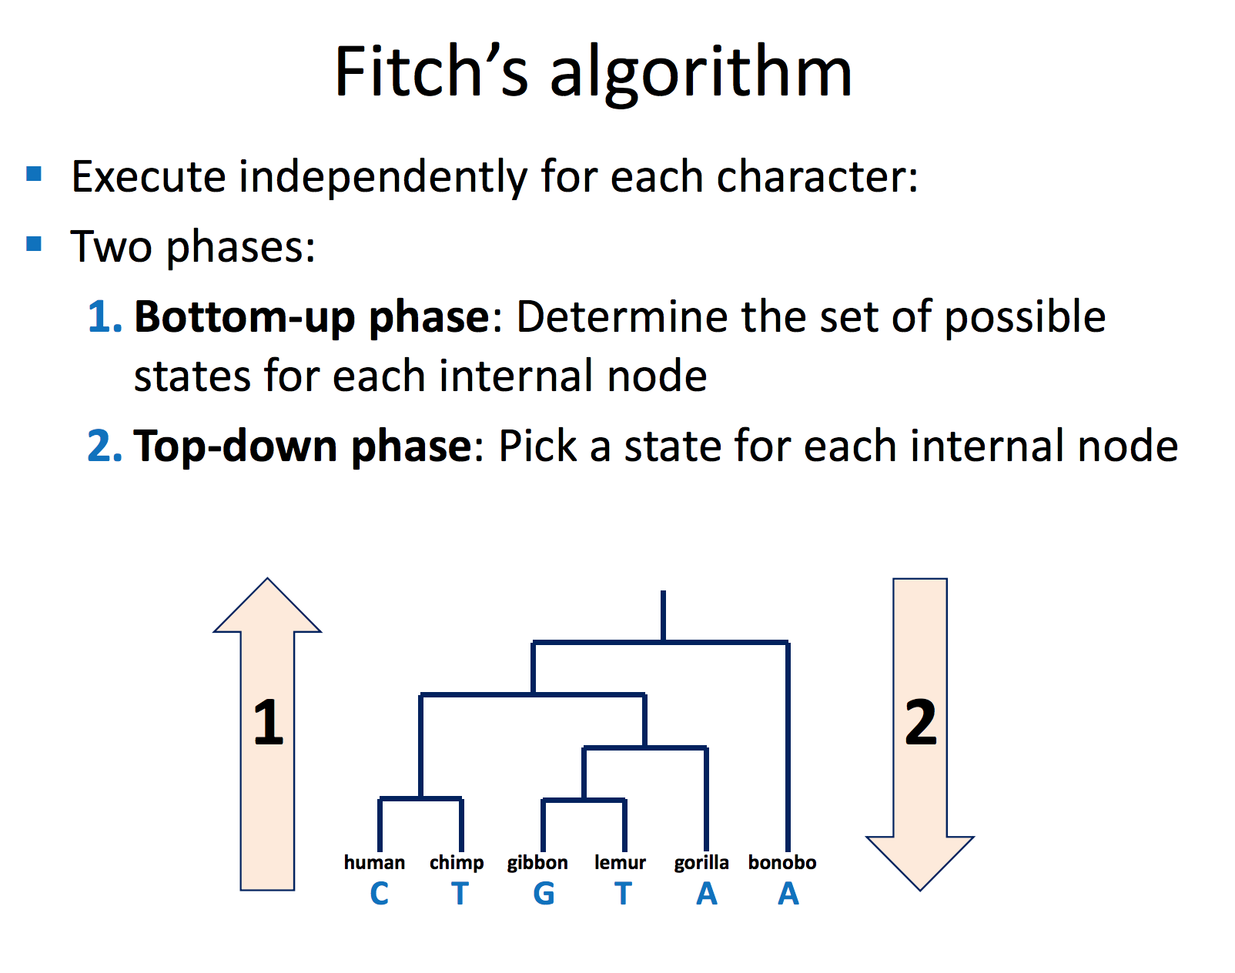
Fitch’s algorithm

Slide 9
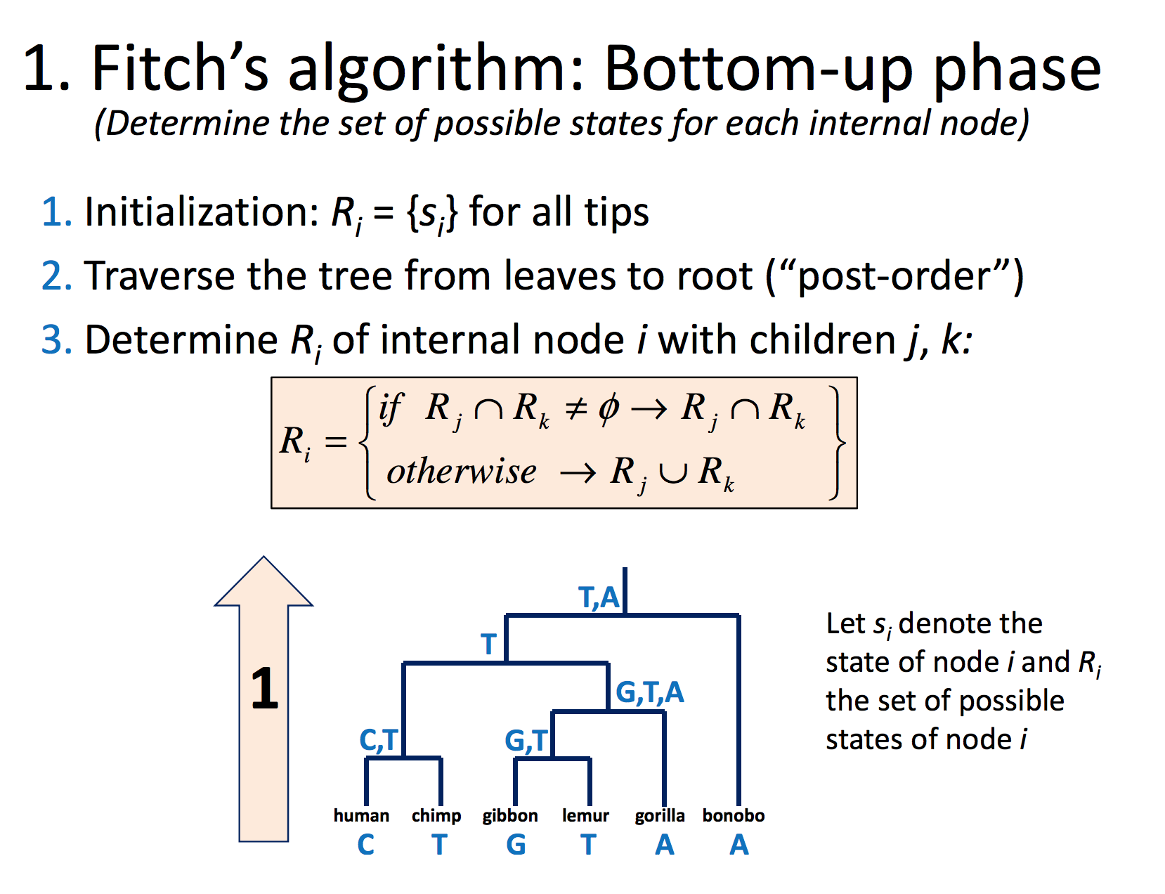
Fitch’s algorithm

Slide 10
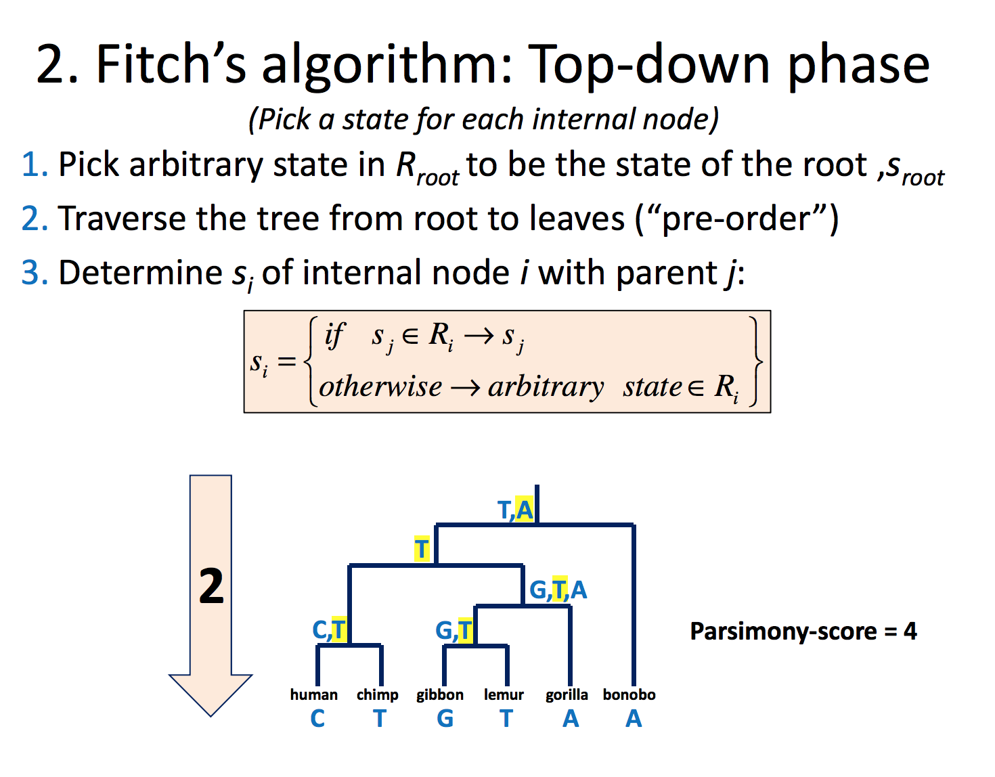
Fitch’s algorithm

Slide 11
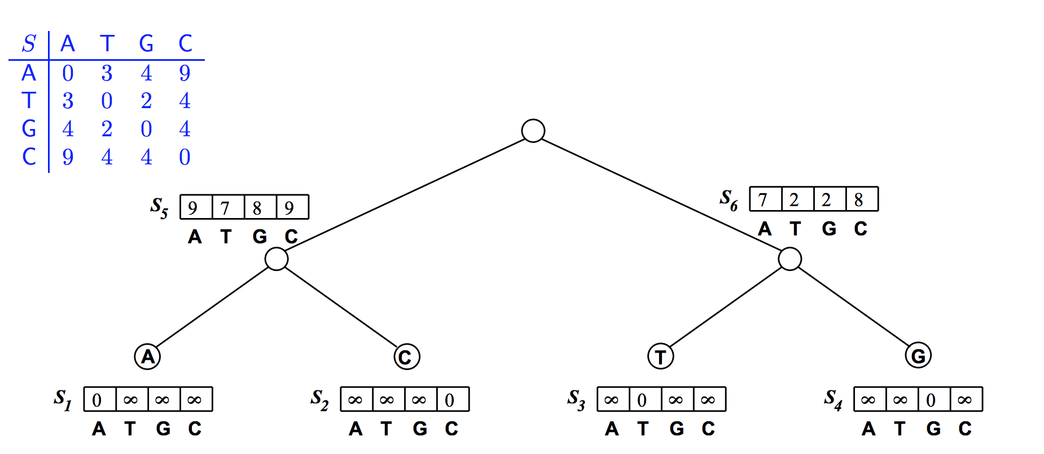
Sankoff Algorithm

Slide 12
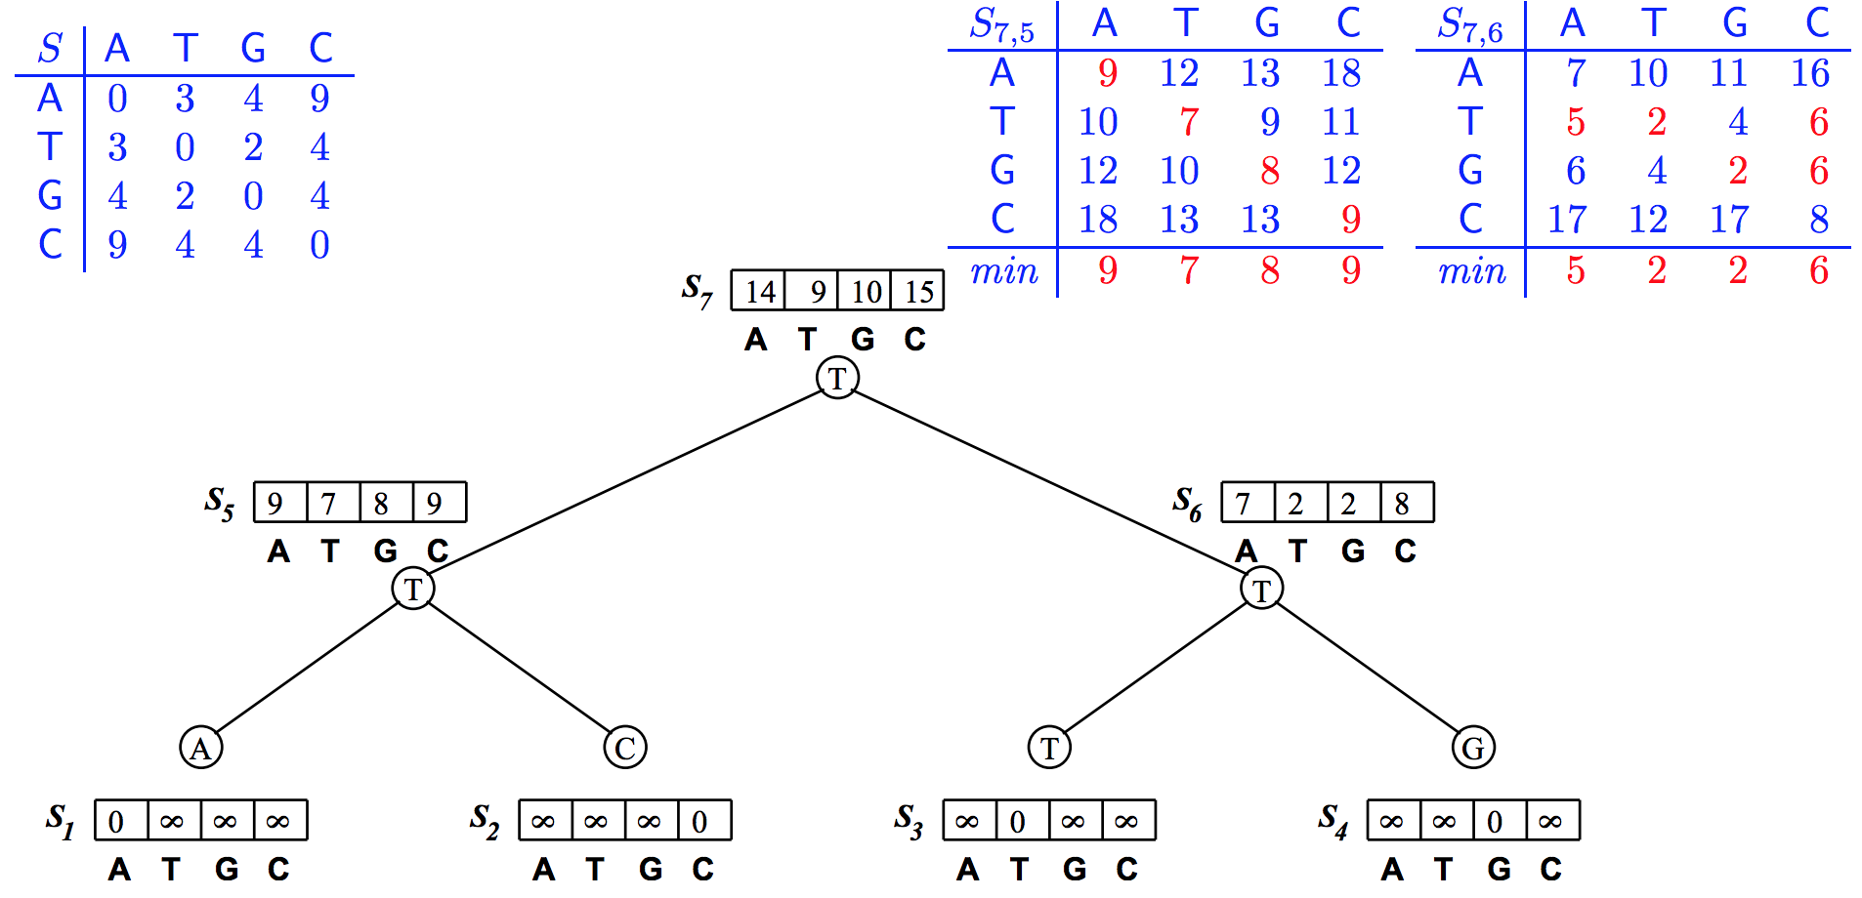
Sankoff Algorithm

Slide 13
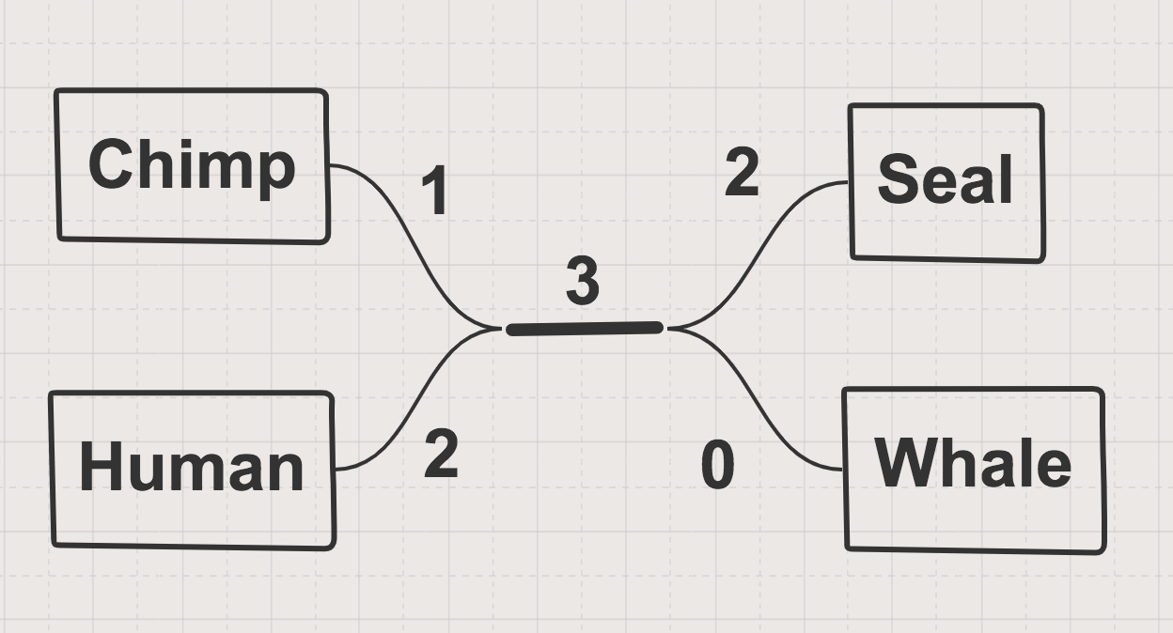
Distance Matrix
Species | Alignment | Distance Matrix
 |  | Chimp | Human | Seal | Whale
Chimp | ACGTAGGCCT | 0 | 3 | 6 | 4
Human | ATGTAAGACT | 3 | 0 | 7 | 5
Seal | TCGAGAGCAC | 6 | 7 | 0 | 2
Whale | TCGAAAGCAT | 4 | 5 | 2 | 0

Slide 14
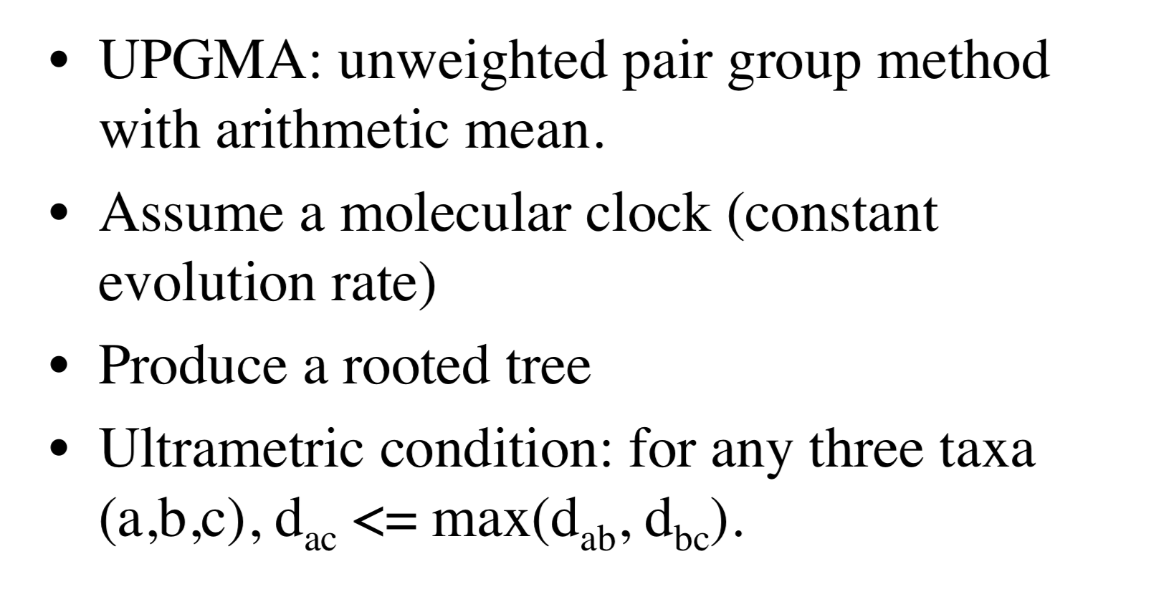
UPGMA Algorithm

Slide 15
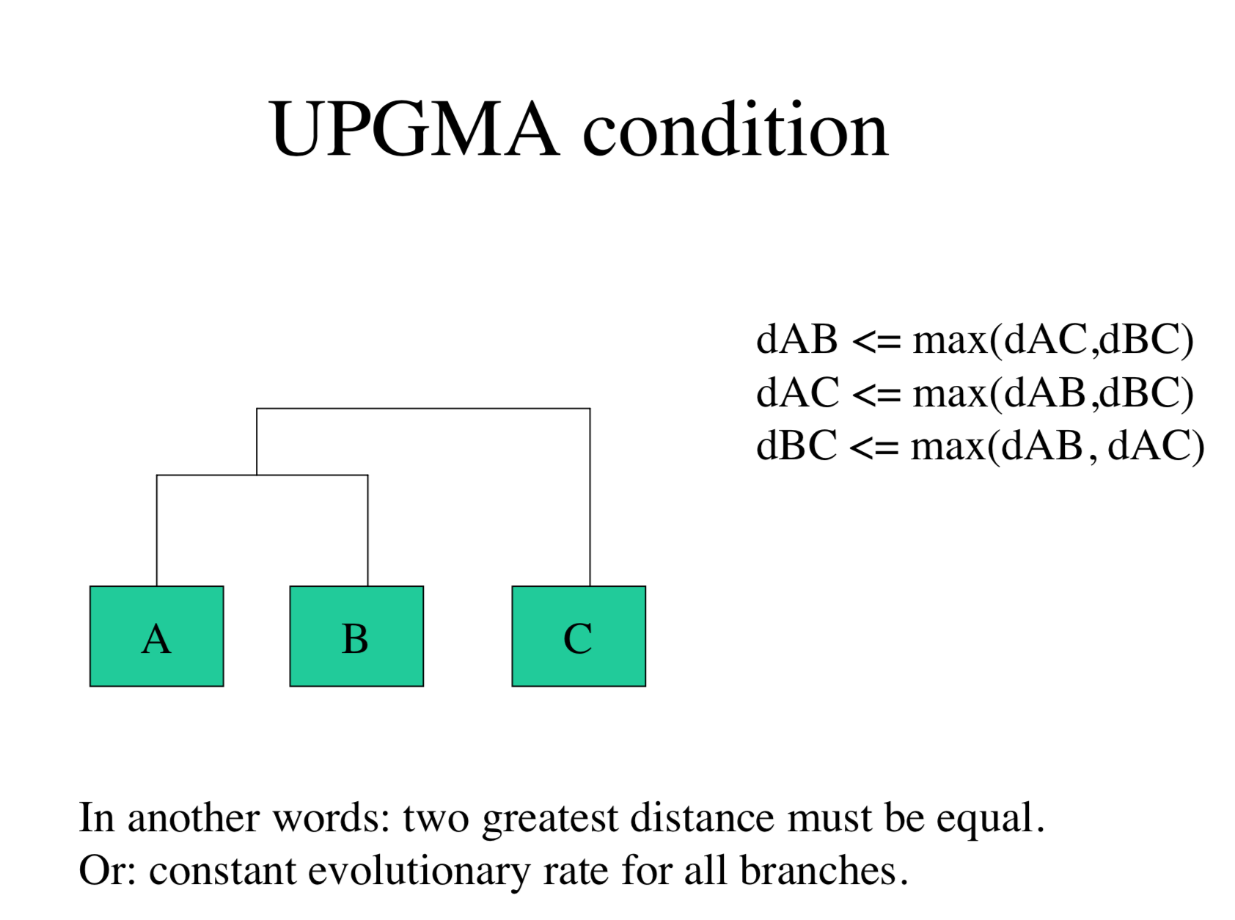
UPGMA Algorithm

Slide 16
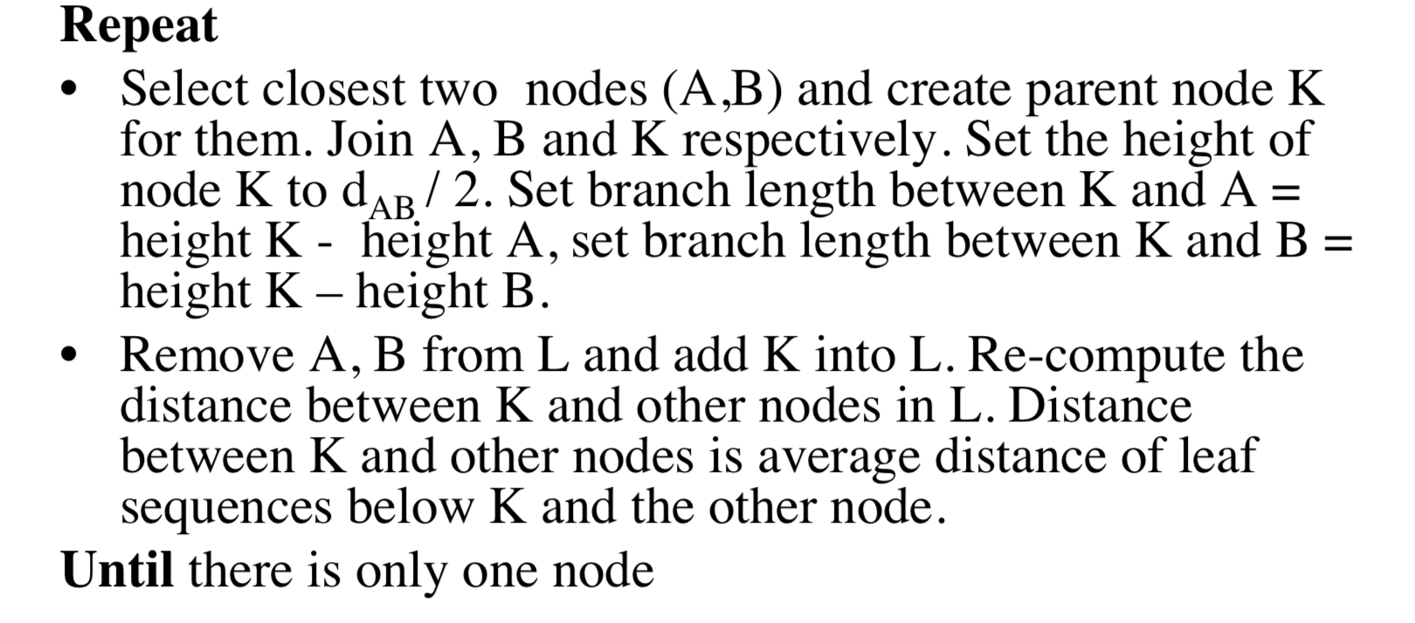
UPGMA Algorithm

Slide 17
UPGMA Algorithm

Slide 18
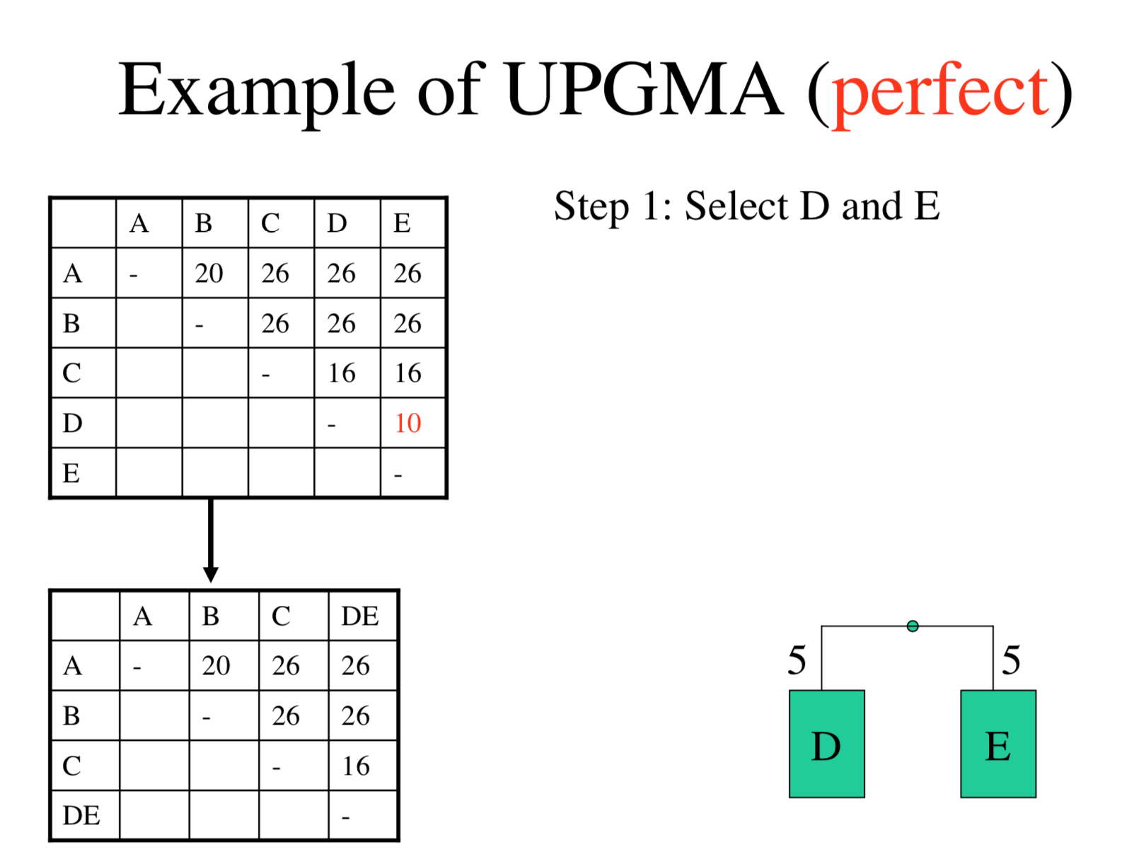
UPGMA Algorithm

Slide 19
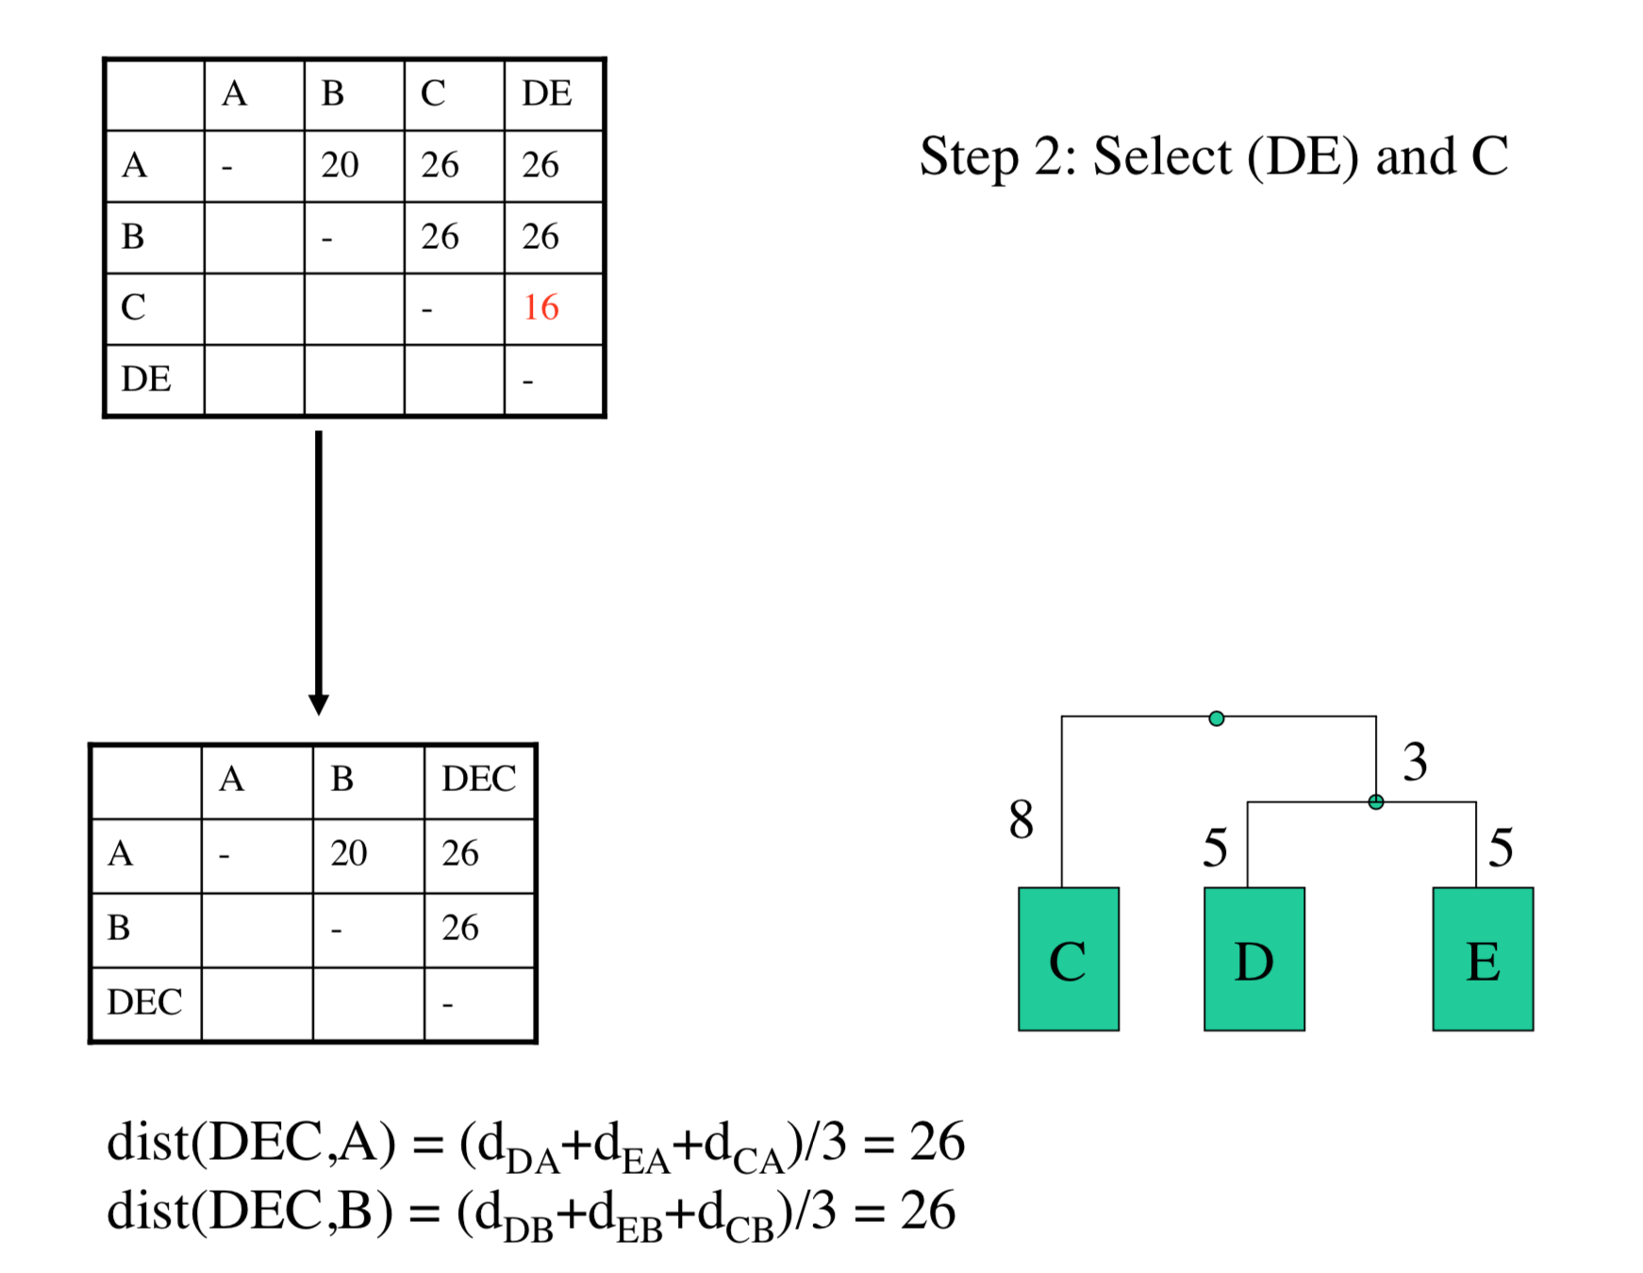
UPGMA Algorithm

Slide 20
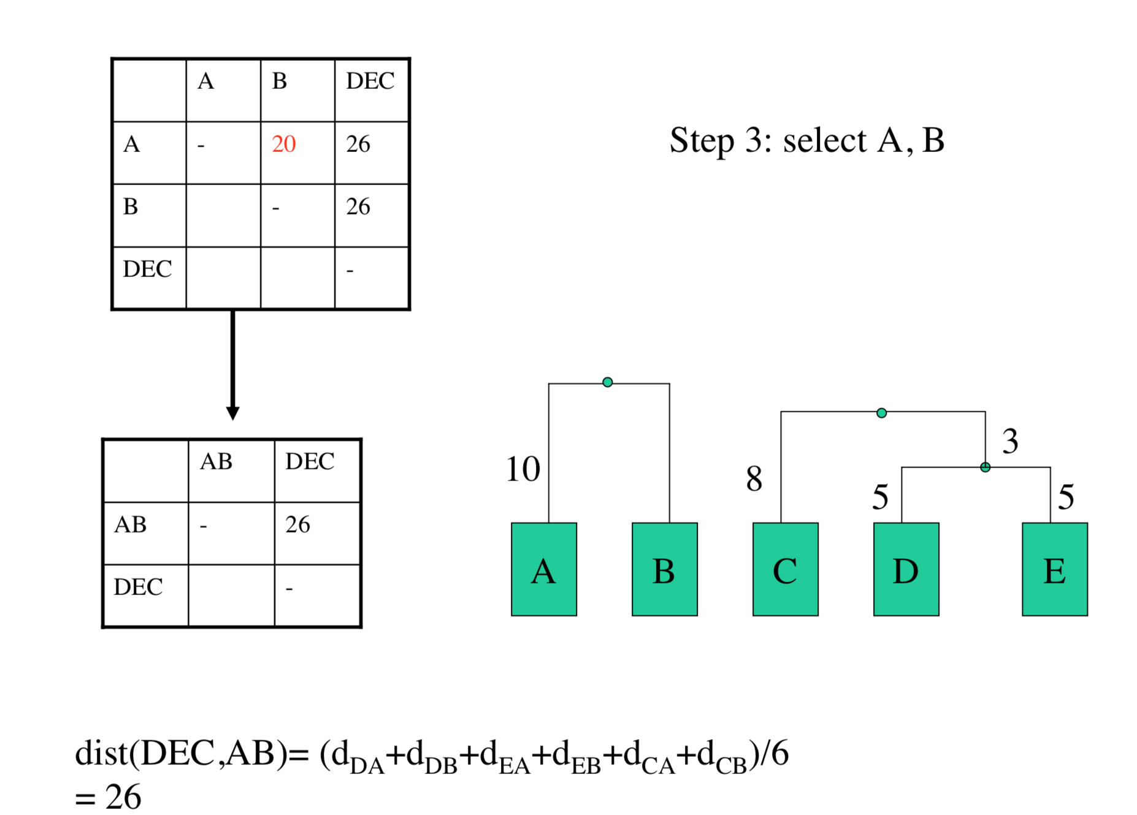
UPGMA Algorithm

Slide 21
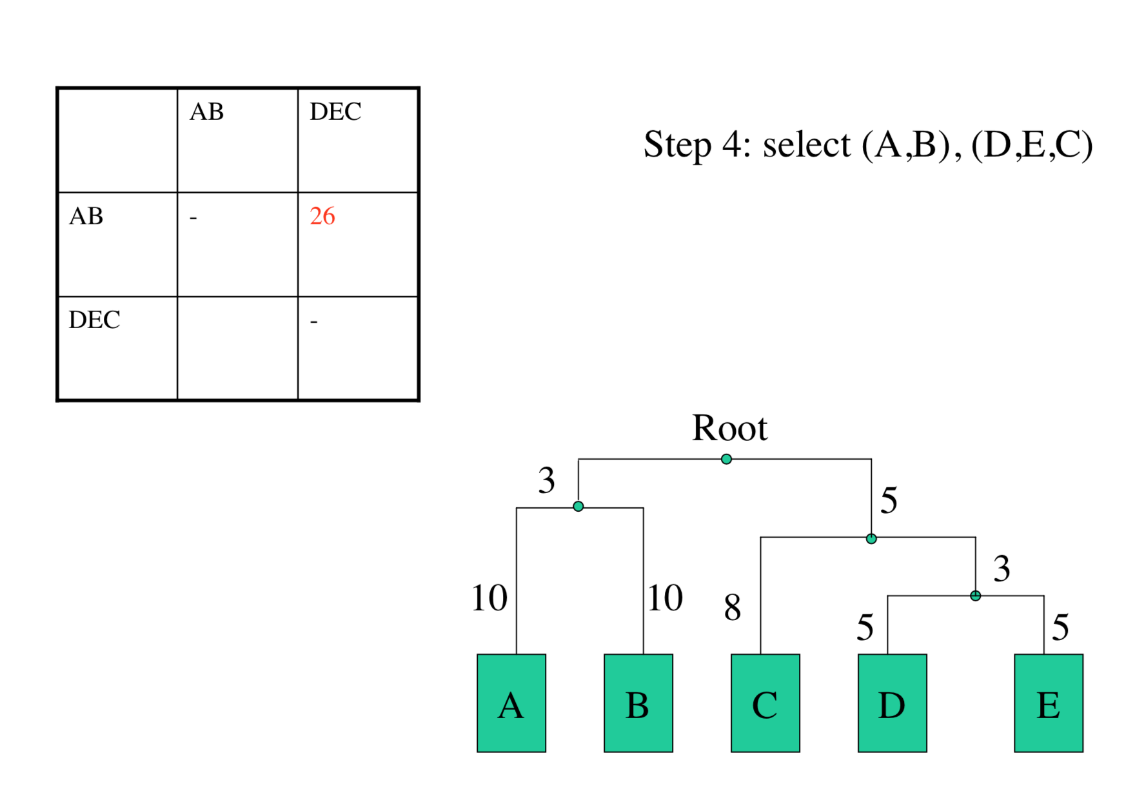
UPGMA Algorithm

Slide 22
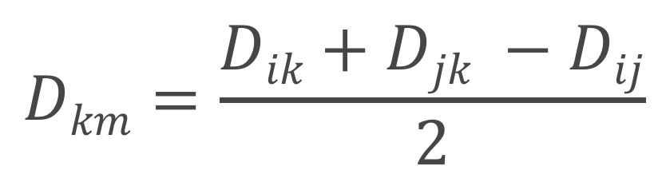
Tree Building – Naïve Approach
$$Dkm=\frac{Dik+Djk −Dij}{2}$$

Slide 23
Tree Building – Naïve Approach
 | C | H | S | W
С | - | 3 | 6 | 4
H |  | - | 7 | 5
S |  |  | - | 2
W |  |  |  | -
Replace S & W by M
D_{mc} = (6 + 4 - 2) / 2 = 4
D_{mh} = (7 + 5 – 2) / 2 = 5
 | C | H | M
С | - | 3 | 4
H |  | - | 5
M |  |  | -
Replace C & H by K
D_{km} = (4 + 5 - 3) / 2 = 3
 | K | M
K | - | 3
M |  | -

Slide 24
Tree Building – Naïve Approach

Slide 25
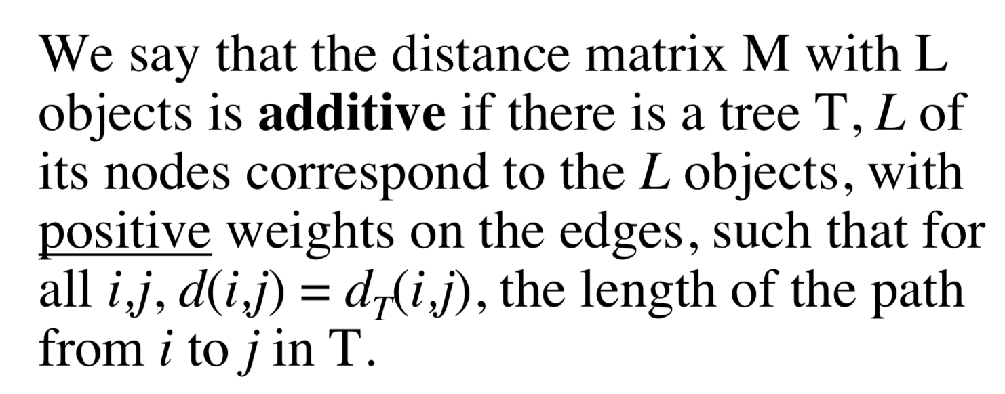
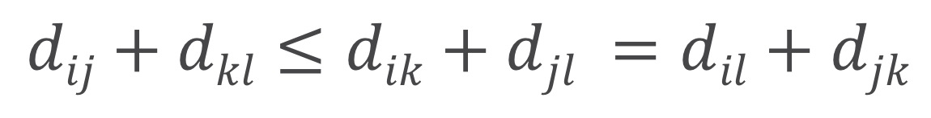
Distance Matrix Additivity
Four Points Condition:
A distance matrix M of L objects is additive iff any subset of four objects may be labeled with i,j,k,l so that:
$$dij+dkl≤dik+djl =dil+djk$$

Slide 26
Neighbor Join Algorithm
 | I | J | M | N
I | - | 13 | 21 | 22
J | 13 | - | 12 | 13
M | 21 | 12 | - | 13
N | 22 | 13 | 13 | -
Pick i,j for which D_{ij} is minimal:
D_{ij} = d_{ij} – (r_{i} + r_{j})
d
 | I | J | M | N
I | - | 21.5 | 17.5 | 17
J | 12.5 | - | 13 | 12.5
M | 12.5 | 17 | - | 16.5
N | 13 | 17.5 | 17.5 | -
 | I | J | M | N
I | - | -21 | -9 | -8
J | -21 | - | -18 | -17
M | -9 | -18 | - | -21
N | -8 | -17 | -21 | -
r
D

Slide 27

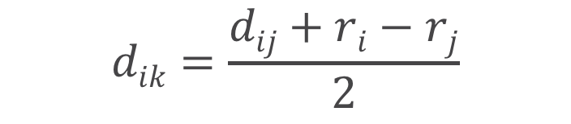
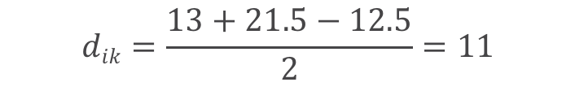
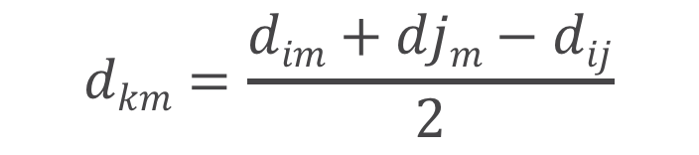



Neighbor Join Algorithm
 | I | J | M | N
I | - | 13 | 21 | 22
J | 13 | - | 12 | 13
M | 21 | 12 | - | 13
N | 22 | 13 | 13 | -
 | K | M | N
K | - | 10 | 11
M | 10 | - | 13
N | 11 | 13 | -
d
d₂
Replace i,j with parent node k:
$$dkm=\frac{dim+djm−dij}{2}$$
$$dkm=\frac{21+12 −13}{2}=10$$
$$dkn=\frac{22+13 −13}{2}=11$$
$$dik=\frac{dij+ri−rj}{2}$$
$$dik=\frac{13+21.5−12.5}{2}=11$$
$$dik=dij −dik$$
$$djk=13 −11=2$$

Slide 28



Neighbor Join Algorithm
 | K | M | N
K | - | 10 | 11
M | 10 | - | 13
N | 11 | 13 | -
 | K | M | N
K | - | -14 | -12
M | -14 | - | -8
N | -12 | -8 | -
d₂
D₂
 | K | M | N
K | - | 11 | 10
M | 13 | - | 10
N | 13 | 11 | -
Adding l node:
$$dln=\frac{11+13 −10}{2}=7$$
r₂
$$dkl=\frac{10+11−13}{2}=4$$
$$dml=10 −4=6$$

Slide 29
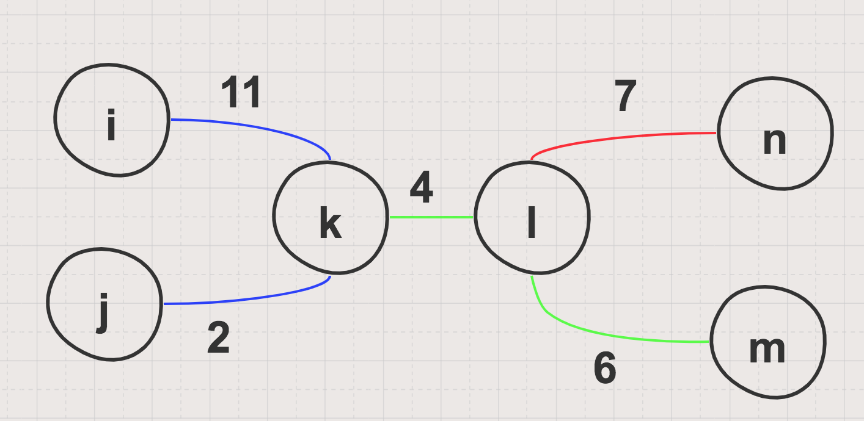
Neighbor Join Algorithm

Slide 30
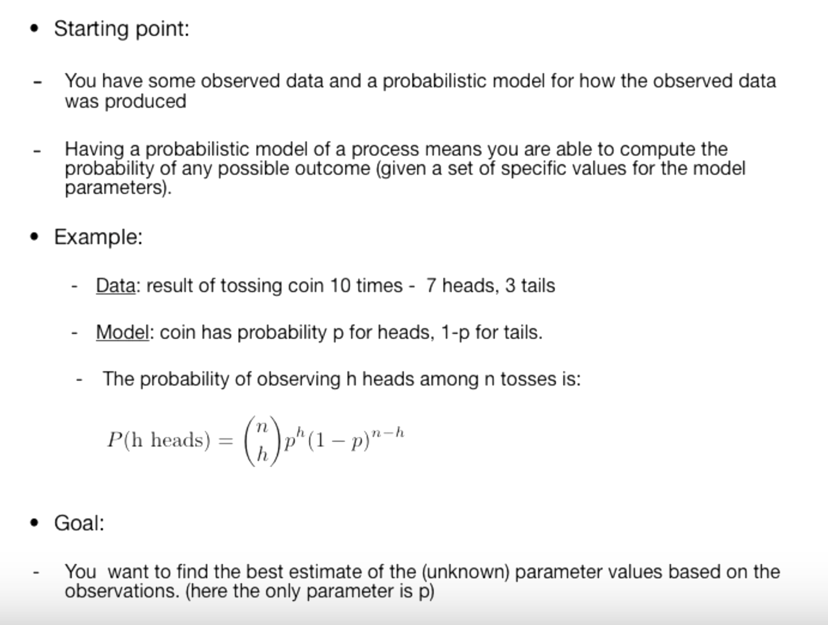
Maximum Likelihood Method

Slide 31
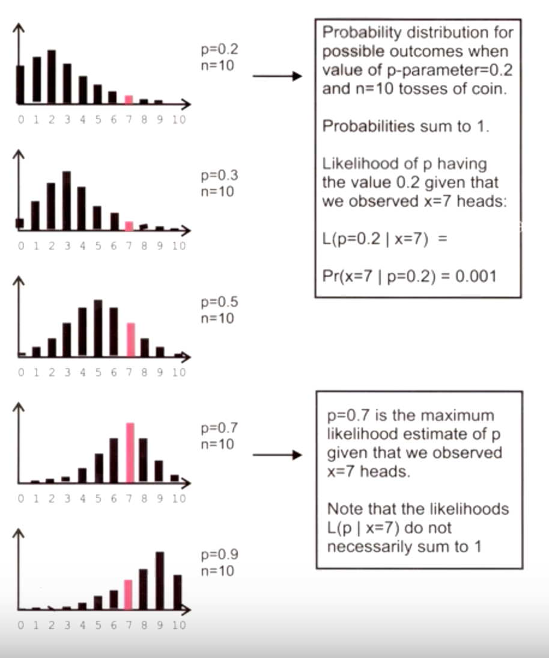
Maximum Likelihood Method
Data: result of tossing coin 10 times – 7 heads, 3 tails
Model: coin has probability p for heads, (1 - p) for tails

Slide 32
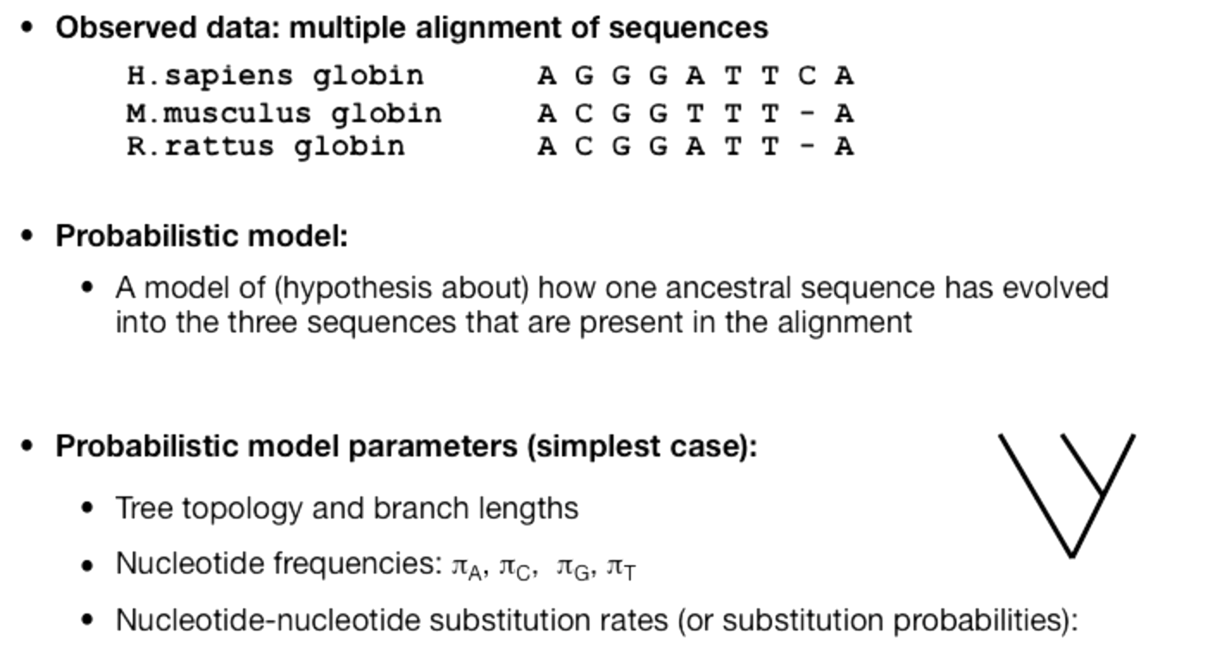
Maximum Likelihood Method

Slide 33
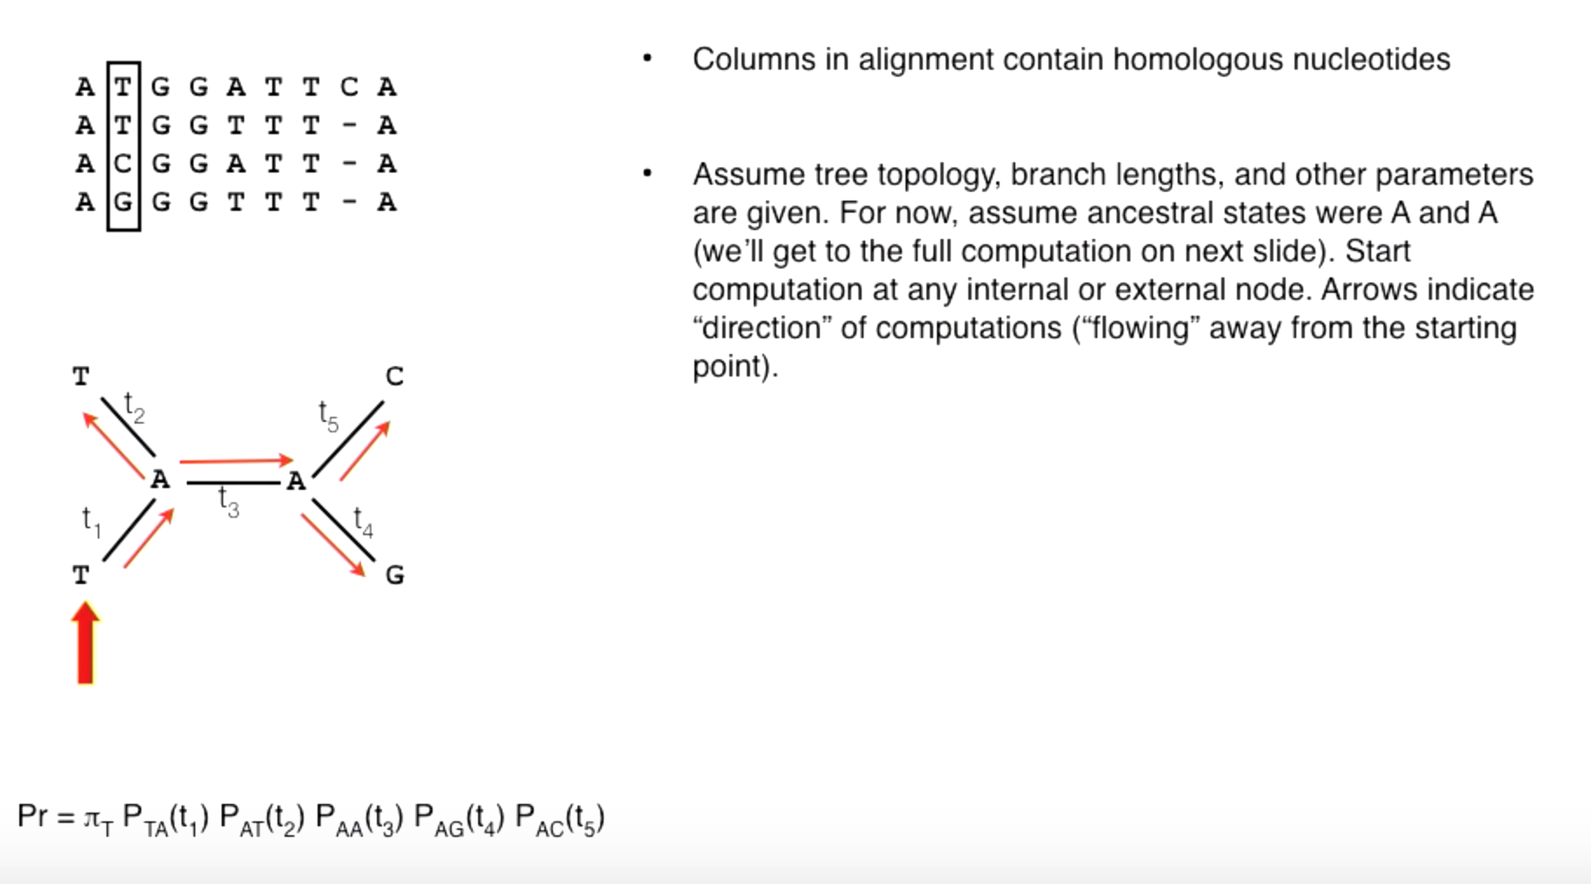
Maximum Likelihood Method

Slide 34
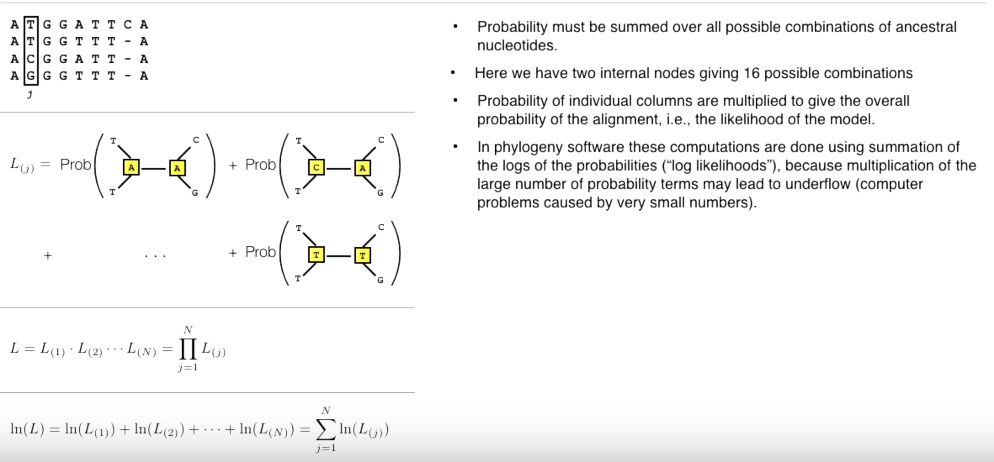
Maximum Likelihood Method

Slide 35
Clustering Algorithms

Slide 36
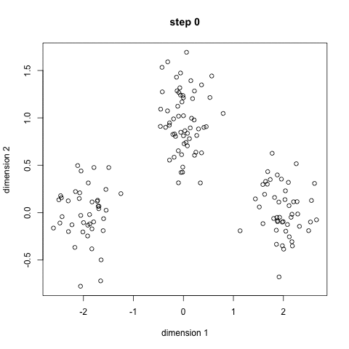
K-Means Clustering

